Slide 1
Introduces
Insulated lineset for ductless applications
August 13, 2024

Slide 2
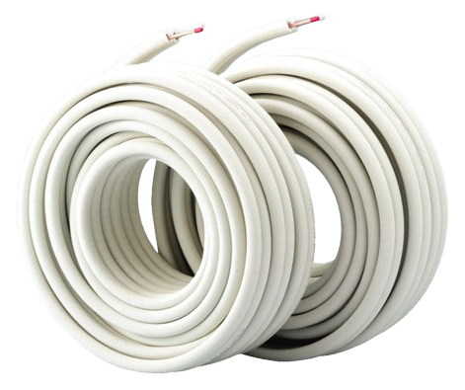
Pre-Paired
Pre-insulated
Flexible
ASTM Ratings

Slide 3
Global Presence
Pre-Paired
Since 1975 Paircoil has sold over 2.5 Billion feet of linesets to HVAC contractors throughout the world.

Slide 4
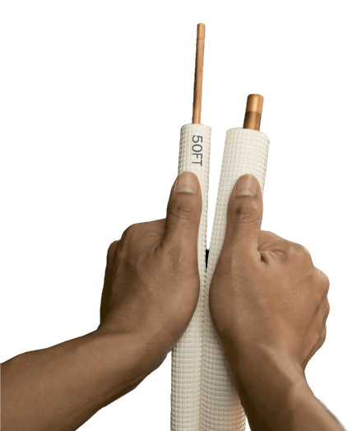
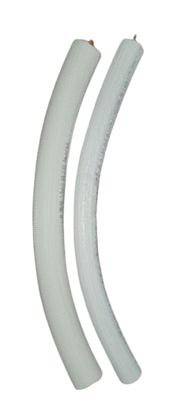
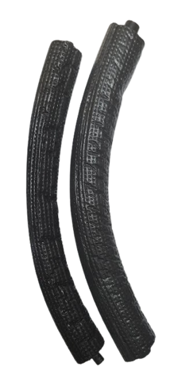
Pre-Paired
Pre-Paired
Both liquid and suction lines are connected
Time and labor saver by pulling both lines at once
Bend both pipes at the same time
Support both lines at once
Much more professional, and clean look
Time Saver!
!
Most competitors do not have this option

Slide 5
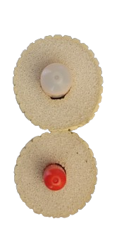
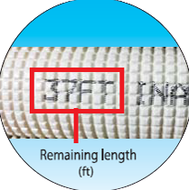
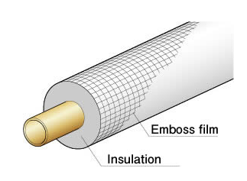
Pre-Insulated
Paircoil has a durable, embossed coating surrounding a dense insulation material
Length markers at every foot for fast, accurate measuring and cutting

Slide 6
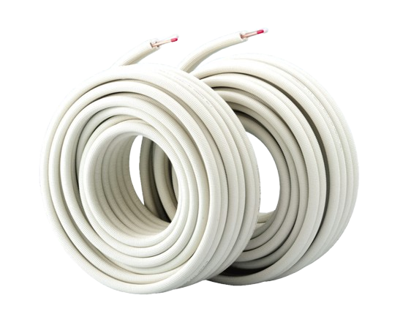
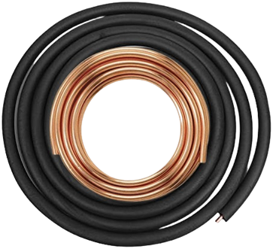
Pre-Insulated
Paircoil comes packaged for protection and easy storage
Both suction and liquid lines insulated
Some manufacturers don’t insulate both lines
!
Some installers have been known to use these type of linesets on mini splits

Slide 7
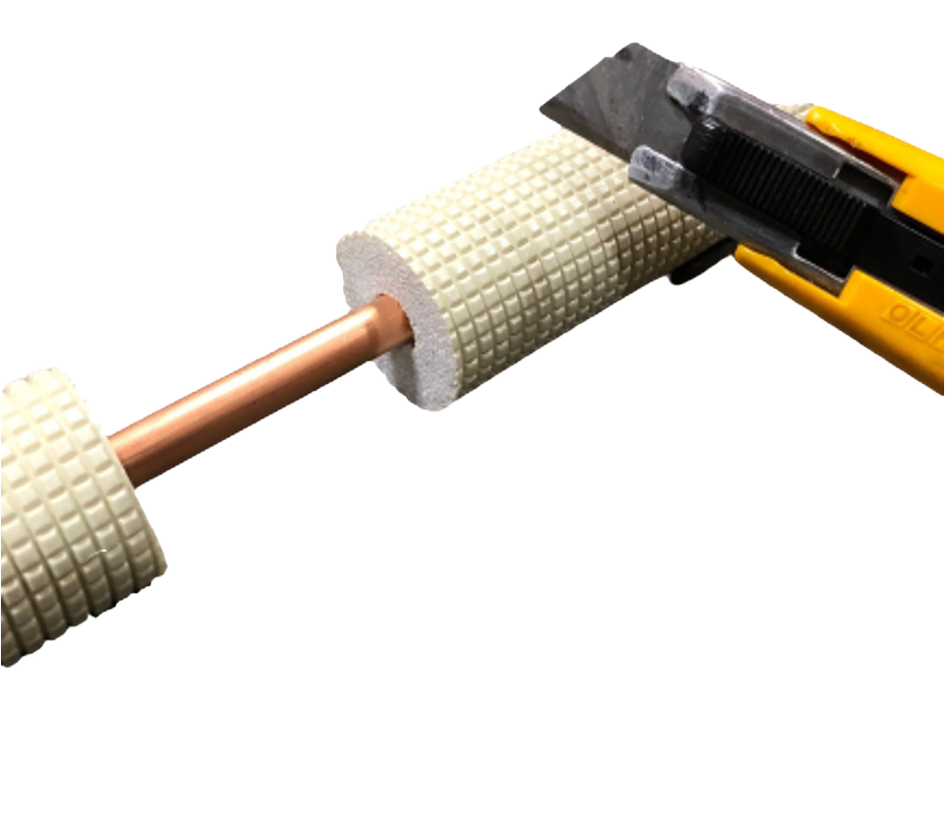
Durable Coating
This coating resists snagging on rough surfaces during installation.
While being easy to cut with a knife.
!
Traditional insulation
Snags
Tears

Slide 8
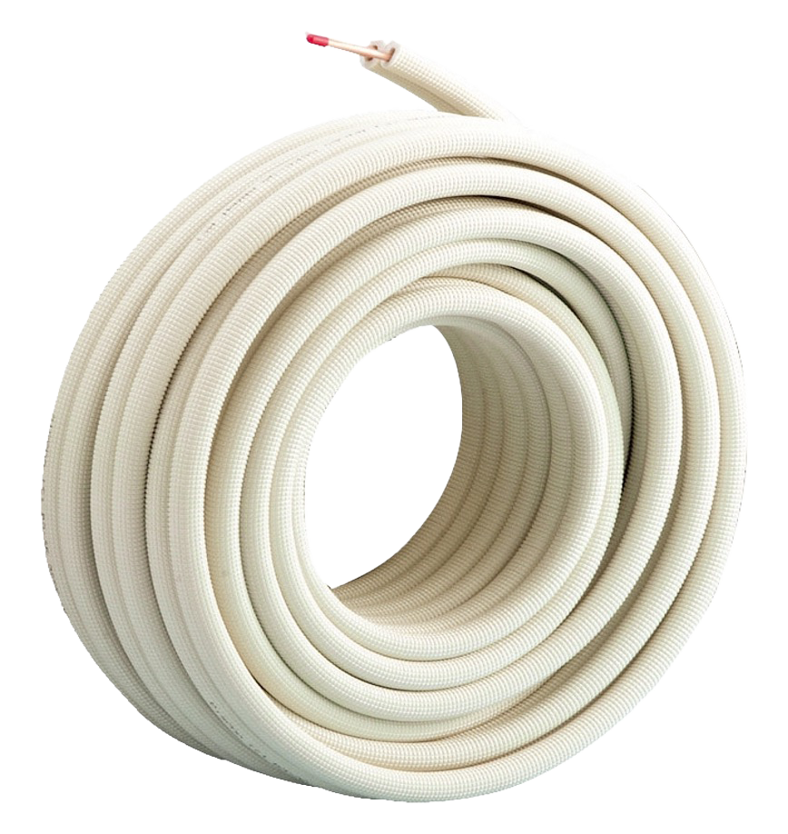
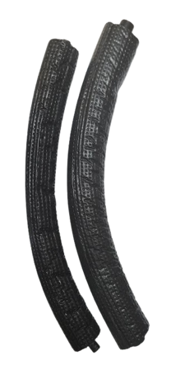
Flexible
Paircoil is made of annealed copper
It is easy to flare and can be easily bent and formed around obstacles during installation
Perfect for existing structures when access is limited
!
Some existing linesets are not copper, are not flared and can be very difficult to install in new or existing structures

Slide 9
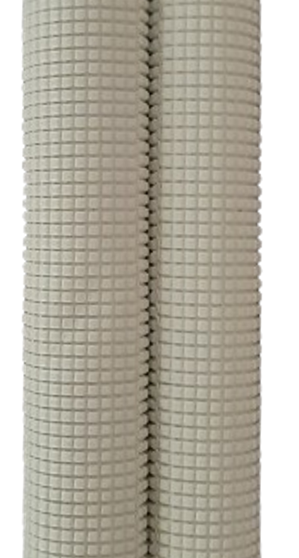
Flexible
The dense insulation helps keep it from kinking when bending
The coating is sturdy and doesn’t tear
!
Other brands of pre-insulated linesets can tear

Slide 10
ASTM Ratings
Most linesets don’t have ratings while others only have pressure ratings.
Paircoil has 9 different ratings!

Slide 11
ASTM Ratings Insulation
Standard |  | Description
1 | ASTM C1427 | Linear Shrinkage
2 | ASTM C411 & C447 | Maximum Use Temperature
3 | ASTM E84 (25/50) | Surface Burning Characteristics
4 | ASTM C518 | Thermal Conductivity
5 | ASTM C1763 | Water Absorption
6 | ASTM E96 | Water Vapor Permeability
7 | ASTM G154 | UV Exposure

Slide 12
ASTM Ratings – Copper Tube
Standard |  | Description
1 | ASTM B280 C12200 DHP | Phosphorus Deoxidized Copper Seamless Tube
2 | ASTM B1003 | Pressure

Slide 13
Technical Specifications
Liquid line OD (Inch) | Suction line OD (Inch) | Insulation thickness (Inch) | Length (Feet) | Type | Item No.
1/4 | 3/8 | 1/2 | 25 | Paired | PC-2325-NA
1/4 | 3/8 | 1/2 | 35 | Paired | PC-2335-NA
1/4 | 3/8 | 1/2 | 50 | Paired | PC-2350-NA
1/4 | 3/8 | 1/2 | 82 | Paired | PC-2382-NA
1/4 | 1/2 | 1/2 | 25 | Paired | PC-2425-NA
1/4 | 1/2 | 1/2 | 35 | Paired | PC-2435-NA
1/4 | 1/2 | 1/2 | 50 | Paired | PC-2450-NA
1/4 | 1/2 | 1/2 | 82 | Paired | PC-2482-NA
1/4 | 5/8 | 1/2 | 25 | Paired | PC-2525-NA
1/4 | 5/8 | 1/2 | 35 | Paired | PC-2535-NA
1/4 | 5/8 | 1/2 | 50 | Paired | PC-2550-NA
1/4 | 5/8 | 1/2 | 82 | Paired | PC-2582-NA
3/8 | 5/8 | 1/2 | 25 | Paired | PC-3525-NA
3/8 | 5/8 | 1/2 | 35 | Paired | PC-3535-NA
3/8 | 5/8 | 1/2 | 50 | Paired | PC-3550-NA
3/8 | 5/8 | 1/2 | 82 | Paired | PC-3582-NA
3/8 | 3/4 | 1/2 | 25 | Paired | PC-3625-NA
3/8 | 3/4 | 1/2 | 35 | Paired | PC-3635-NA
3/8 | 3/4 | 1/2 | 50 | Paired | PC-3650-NA
3/8 | 3/4 | 1/2 | 82 | Paired | PC-3682-NA
Insulation Material: cross-linked polyethylene
Tube: copper
ASTM B280 C12200 DHP
Application: ductless installation
Size: Multiple sizes
Color: Ivory-colored insulation reflects solar heat for better energy efficiency.
A2L Compatible

Slide 14
19750 S. Vermont Ave. Suite 140, Torrance, CA 90502 USA

